Slide 1

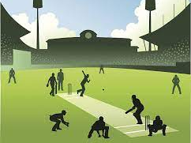
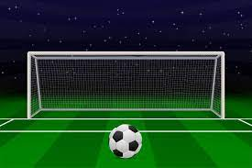
Project Presentation
On
SPORTS SCORESHEET ORGANIZER
BIT-1st Semester
Group Members:
1. Sagar Upadhyaya (313346)
2. Shubham Ghimire (313348)
3. Dhiraj Sapkota (313326)

Slide 2

Contents
Introduction
Objective
Literature Review
Features
Algorithm
Flowchart
Gantt Chart (Time Scheduling)
Conclusion
References (APA Format)

Slide 3
Introduction
Maintaining scoresheet of the games without using system creates a lot of problem in data entry, data update as well as data access. So, we built up the system that can be best use for maintaining scoresheet of the games.
Sports Scoresheet Organizer is the project that is built for the maintenance of the scoresheet during the games i.e. cricket and football. For e.g. this program can create, update, and display the scoresheet which includes the match detail such as total runs, total wickets, names of batsmen and bowlers, venue, date of match, etc. In case of cricket. Similarly different records such as total goals, shoots, names of player and their respective position, etc. In case of football.

Slide 4
OBJECTIVES
1
To provide user the ability to create cricket and football scoresheet
2
To provide user the ability to modify scoresheet records.
2
To provide user the ability to view existing scoresheet records.

Slide 5
Literature review
During our research we found few scoresheet related project that has already been developed using c language like mini project on cricket scoresheet but those project was just the small scoresheet record keeping project containing the minimum features like those project only had the features to store and view records like player name, how many run they score using structure. There was no any formatting record like in real scoresheet. So, we took help from other GUI based cricket and football application which made us easy to do our project.

Slide 6
Limitation of existing system
1
different detail like match detail, each player’s detail & scores, match summary, etc. were missing.
2
those system also lacked security function.
3
Innings detail were not specified
4
those project didn’t had the feature to edit the record.

Slide 7



Features
2
Access to create, modify and view the scoresheet records
3
Access of match info regarding games
4
Records are specified separately
5
Program stores each player’s record

Slide 8
ALGORITHM
Step 1: Start
Step 2: Display Opening Interface.
Step 2: Input password
Step 3: IF password is true then goto step 4
otherwise display “Incorrect password please enter again” goto step 2
Step 4: Display Home page: choose
Create
Browse
Quit
Step 5: If user choose 1 then : goto step 6
Else if user choose 2 go to step 49
Else terminate the program
Step 6: Display and choose
1. cricket
2. football

Slide 9
ALGORITHM
Step 7: If user choose 1 goto step 8 else if goto step 28 else goto step 4
Step 8: Display the table 1.1 (Details)
Step 9: Input cricket league (multiple choice)
Step 10: Input the number of overs
Step 11: Input venue, date of match, name of teams (command for inputting real time date)
Step 12: Input total no. of players in each team
Step 13: Display
continue
edit
Back
Step 14: if user choose 1 then goto step 15
else if user choose 2 then enable editing
else goto step 4

Slide 10
ALGORITHM
Step 15: Display table for team 1
Step 16: Input JN, name, position of the player
Step 17: Display table for team 2
Step 18: Input JN, name, position of the player
Step 19: Display toss won by:
1.team 1
2.team 2
and choose(bat/ball) by toss winner
Step 20: Display "title", First Inning
Step 21: input a file name for first inning batting team and Display table for first inning
Step 22: Display JN and name of each player and input run made by each player
Step 23: Input file name for first inning bowling team
Step 24: Display JN and name of players of bowling team

Slide 11
ALGORITHM
Step 25: input wicket taken and run given by each player
Step 26: display total wicket taken and total run given
Step 27: input total extra run given from misconducts
Step 28: display total run scored in the first inning and target run
Step 29: input a file name for first inning batting team and Display table for second inning
Step 30: Display Jn and name of each player and input run made by each player
Step 31: Input file name for second inning bowling team
Step 32: Display JN and name of players of bowling team
Step 33: input wicket taken and run given by each player
Step 34: display total wicket taken and total run given
Step 35: input total extra run given from misconducts
Step 36: Display result

Slide 12
ALGORITHM
Step 38: Display "title - Soccer scoresheet" the table 1.2(Details)
Step 39: Input football league (multiple choice)
Step 40: Input venue, date of match, name of teams (command for inputting real time date
Step 41: Input coach name of each team
Step 42: Input total no. of players in each team including substitution
Step 43: Display
continue
edit
Back
Step 44: if user choose 1 goto step 45
Else if user choses 2 goto step 39
Else go to step 4

Slide 13
ALGORITHM
Step 45: Display table for team 1 and input players #JN, name, position of respective team
Step 46: Display table for team 2 and input players $JN, name, position respective team
Step 47: input file name for team 1’s football score
Step 48: Display JN and name of each players
Step 48: input total shoot and total goal by each player
Step 49: input total misconduct
Step 50: input total saves and total assist
Step 51: Display total shoot made and total goals by team 1
Step 52: input file name for team 2’s football score
Step 53: Display JN and name of each players
Step 54: input total shoot and total goal by each player
Step 55: input total misconduct
Step 56: input total saves and total assist
Step 57: Display total shoot made and total goals by team 2
Step 58: Display result

Slide 14
ALGORITHM
Step 59: Display: 1.cricket || 2. Football
Step 60: If user choses 1 goto step 61 Else goto step 74
Step 61: display the first table for details of match
Step 62: display the second table for first team jersey number, name and position of each players
Step 63: display the table of second team jersey number, name and position of each players
Step 64: Display the table of first inning for both batting team and blowing team.
Step 65: Display wicket taken and run given by each player
Step 66: display total wicket taken and total run given
Step 67: Display total extra run given from misconducts
Step 68: display total run scored in the first inning and target run
Step 69: display the table for second inning for both batting and lowing team
Step 70: Display wicket taken and run given by each player
Step 71: display total wicket taken and total run given
Step 72: input total extra run given from misconducts
Step 73: Display result

Slide 15
ALGORITHM
Step 74: Input file name to display match detail
Step 75: display the first table for details of match
Step 76: input file name to display player detail of team 1
Step 77: display the table for first team jersey number, name and position of each players
Step 78: input file name to display player detail of team 2
Step 79: display the table of second team jersey number, name and position of each players
Step 80: input file name for team 1’s football score
Step 81: display JN and name of each players
Step 82: display total shoot and total goal by each player
Step 83: display total misconduct
Step 84: display total saves and total assist
Step 85: Display total shoot made and total goals by team 1

Slide 16
ALGORITHM
Step 86: display file name for team 2’s football score
Step 87: Display JN and name of each players
Step 88: display total shoot and total goal by each player
Step 89: display total misconduct
Step 90: display total saves and total assist
Step 91: Display total shoot made and total goals by team 2
Step 92: Display result
Step 93: goto step 4
Step 94: End

Slide 17
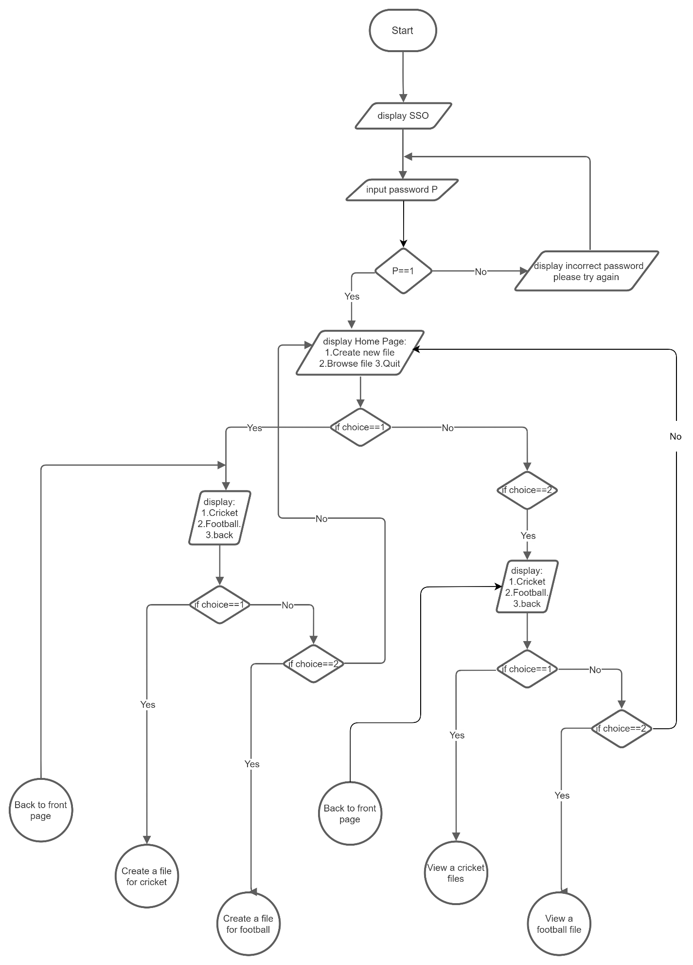
FLOWCHART

Slide 18
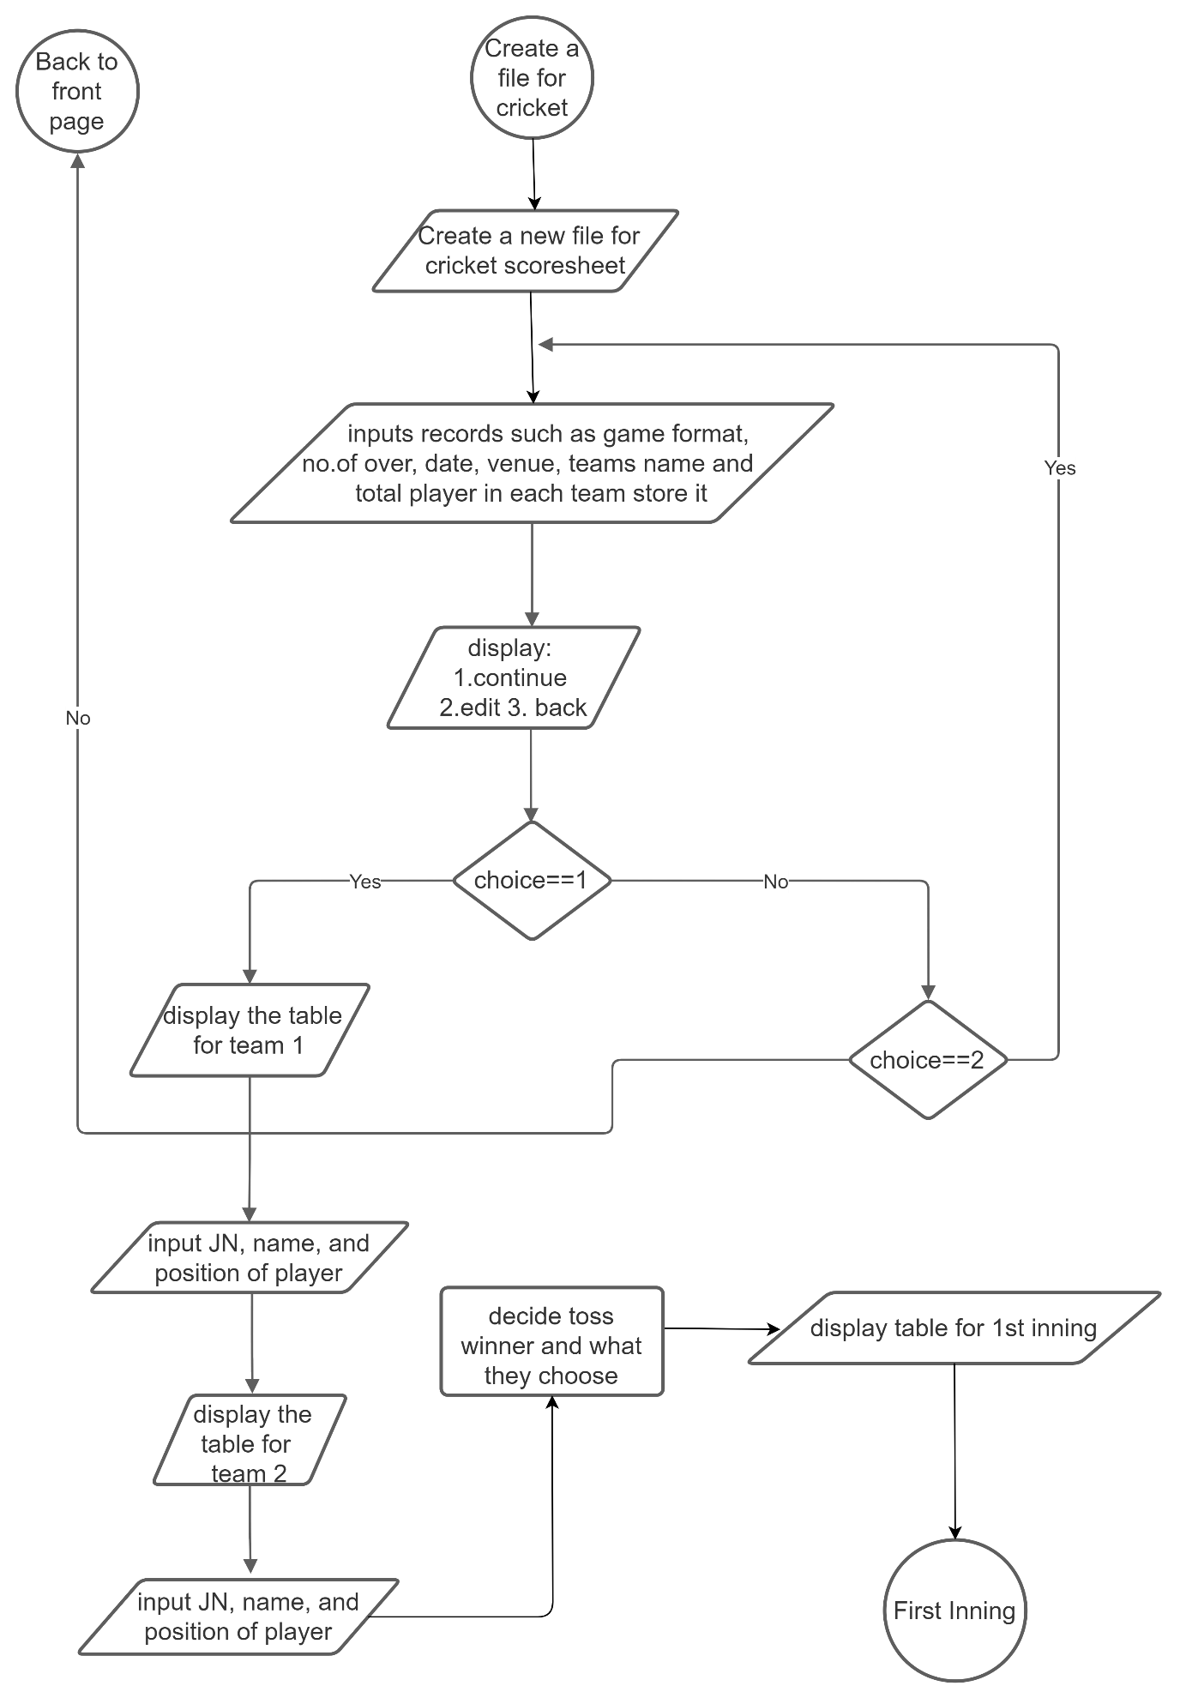
FLOWCHART

Slide 19
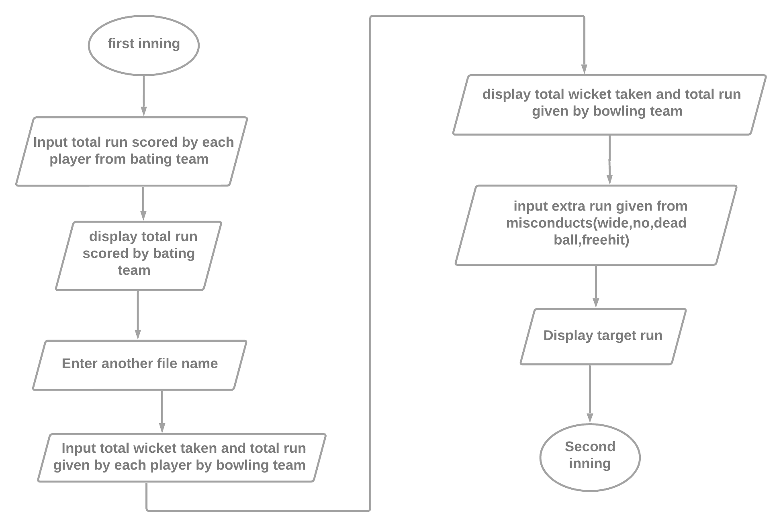
FLOWCHART

Slide 20
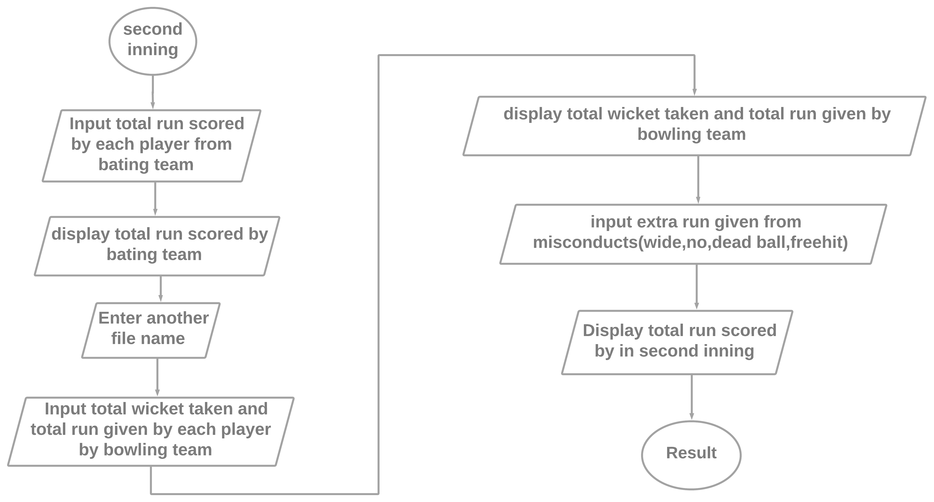
FLOWCHART

Slide 21
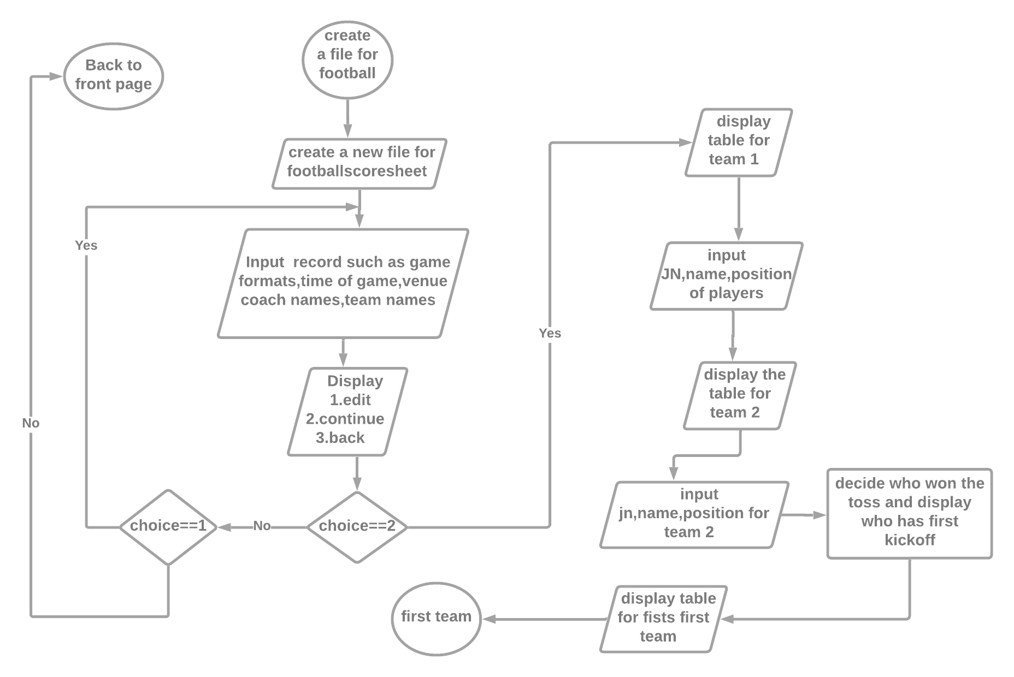
FLOWCHART

Slide 22
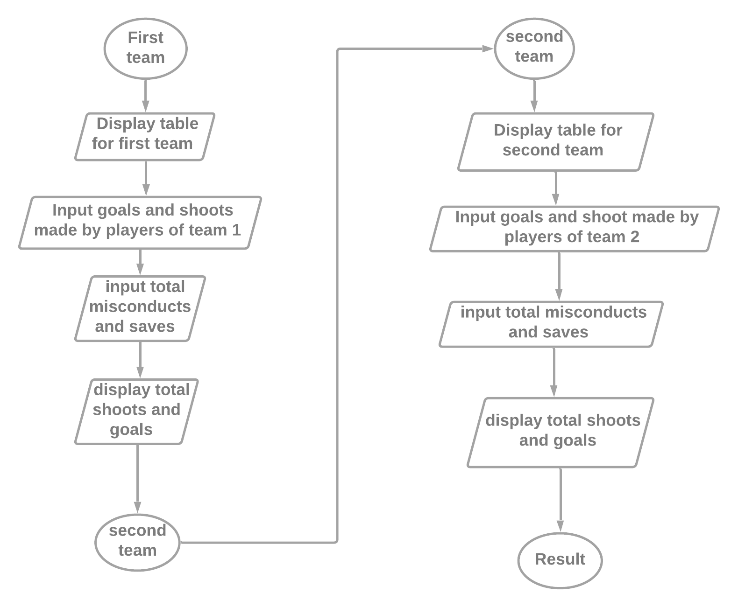
FLOWCHART

Slide 23
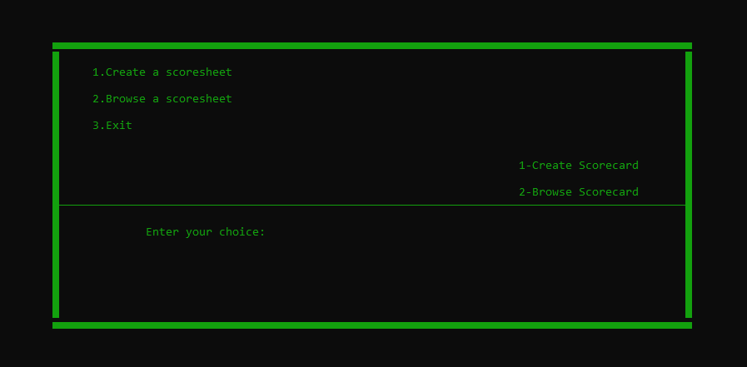
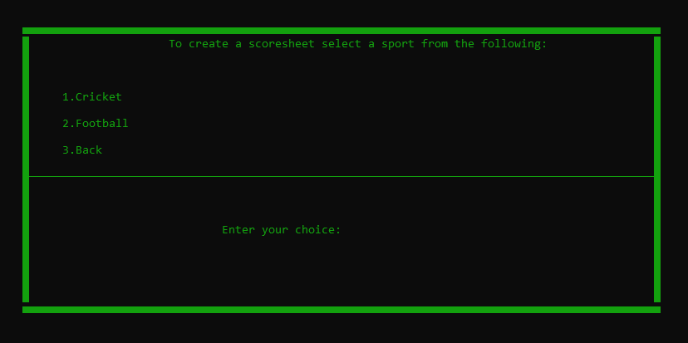

Slide 24
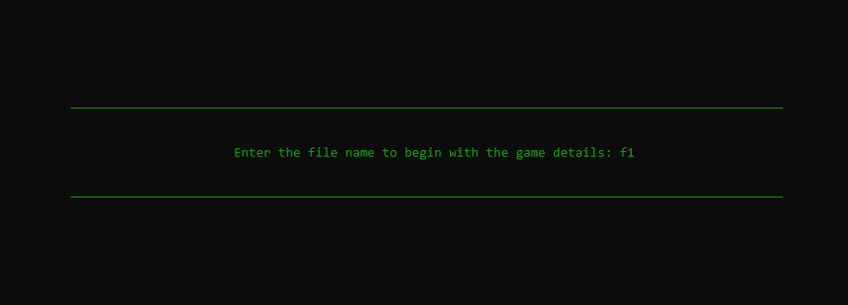

Slide 25
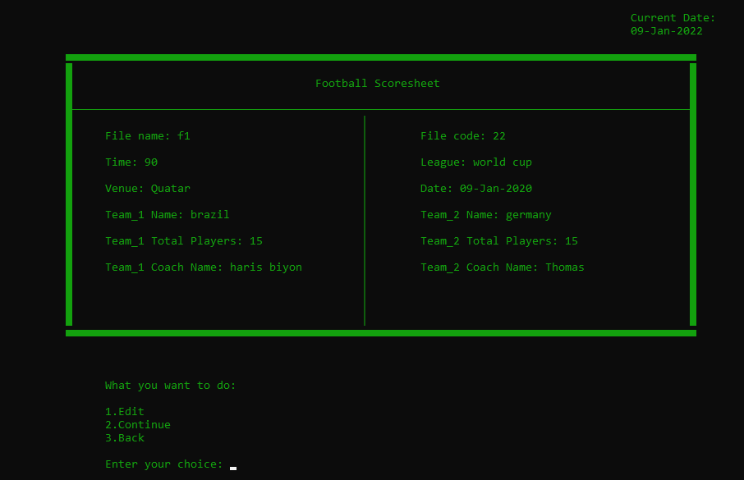

Slide 26
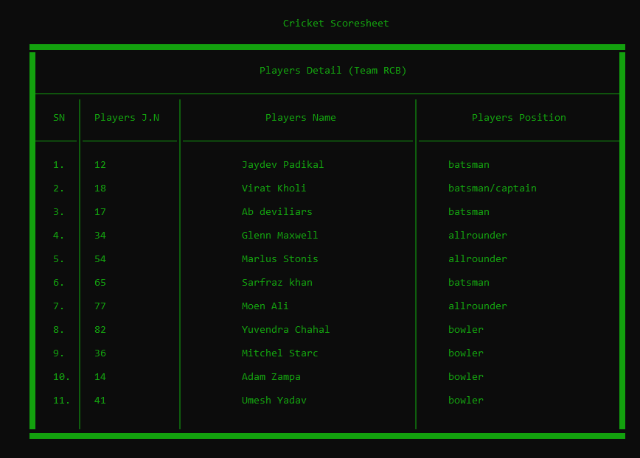

Slide 27
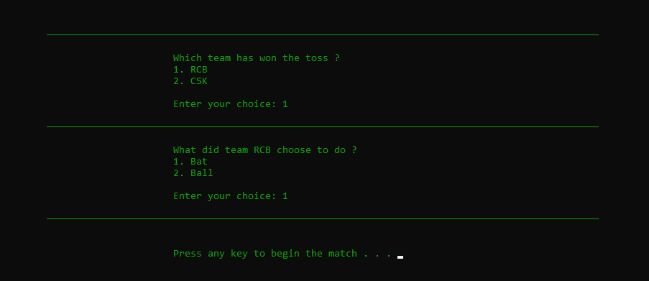

Slide 28
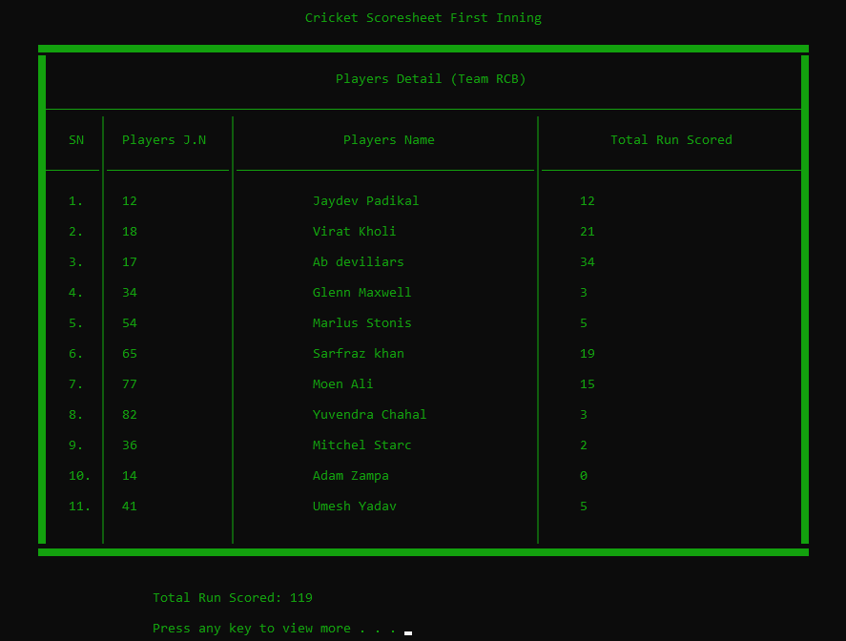

Slide 29
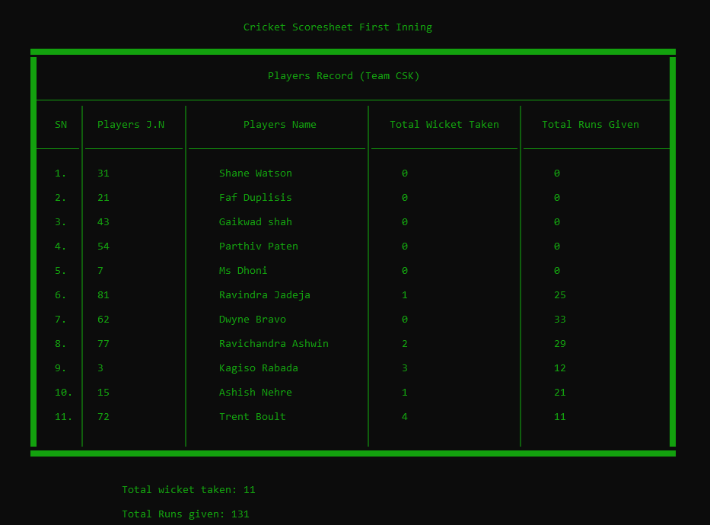

Slide 30
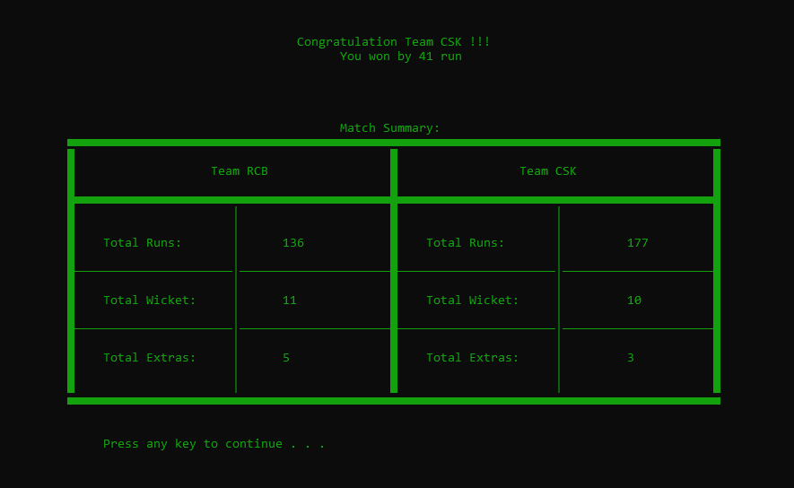

Slide 31
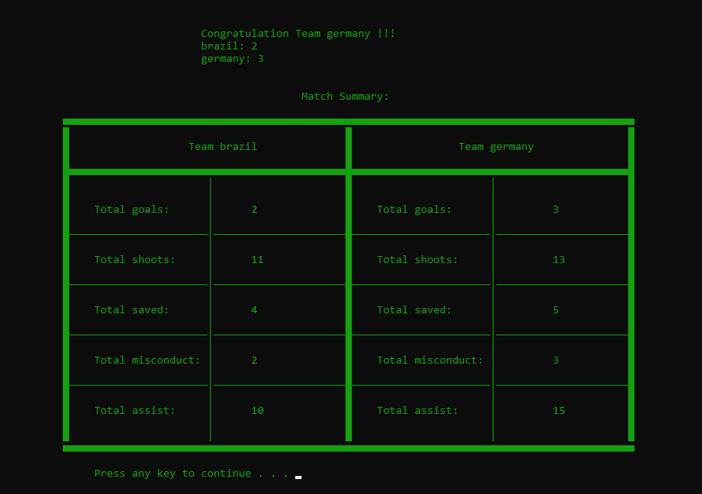

Slide 32
GANTT CHART
Task Name | 2021
 | June | July | Aug | Sep | Oct | Nov | Dec
Planning
Concept submission
Research and analysis
Design
Algorithm/Flowchart
Coding
Debugging and Testing
Documentation

Slide 33
conclusion
As we know that no any program can be 100% reliable and efficient. So there are also some drawbacks from our system like it cannot perform all the required function as of professional one. It’s simply a scoresheet record keeping system of cricket and football. It is actually a user-friendly as it is easy to use by just following the instructions which are appeared on the screen. The most important things we learned from this project is to use various file handling and user defined functions, structure, arrays and so on.
Finally, This project has been really helpful to us in gaining new ideas, skills and experience of using c programming that is sure to be useful for our future project and career.

Slide 34
references
Abiral, B (29 june, 2011). Project on c programming. Retrieved july 2, 2021 from https://www.Scribd.Com/document/58979208/project-on-c-programming
sasidhar.K (16 sep, 2014). Mini project on c. Retrieved july 22, 2021 from https://www.Amfastech.Com/2014/09/10-miniprojects-inc-with-sourcecode.Html
tutorialspoints (jan 4,2015). C tutorial. Retrieved aug 10, 2021 from https://www.Tutorialspoint.Com/cprogramming/index.Htm
jaydeep.D (n.D) 50+ interesting c project. Retrieved aug 02, 2021 from https://learnprogramo.Com/50-interesting-programming-c-projects-downloadwith-source-code/
Codewithcteam (22 mar, 2018). 50++ C project. Retrieved aug 04, 2021 from https://www.Codewithc.Com/c-projects-with-source-code/
atharv, d (july 19, 2021). 20 best c project. Retrieved aug 08, 2021 from https://www.Skyfilabs.Com/blog/20-best-c-programming-projects-for-beginner

Slide 35


Slide 36


